Slide 1




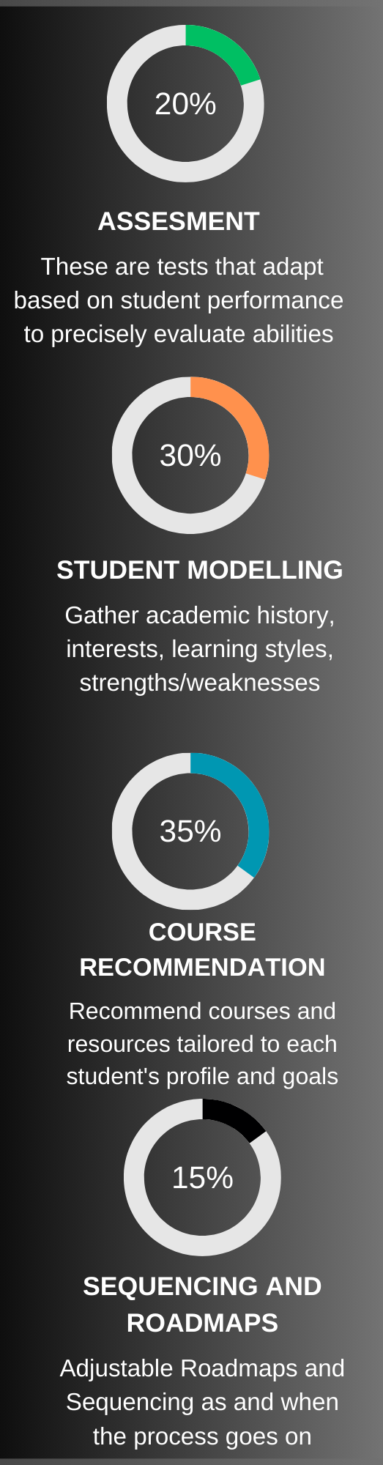
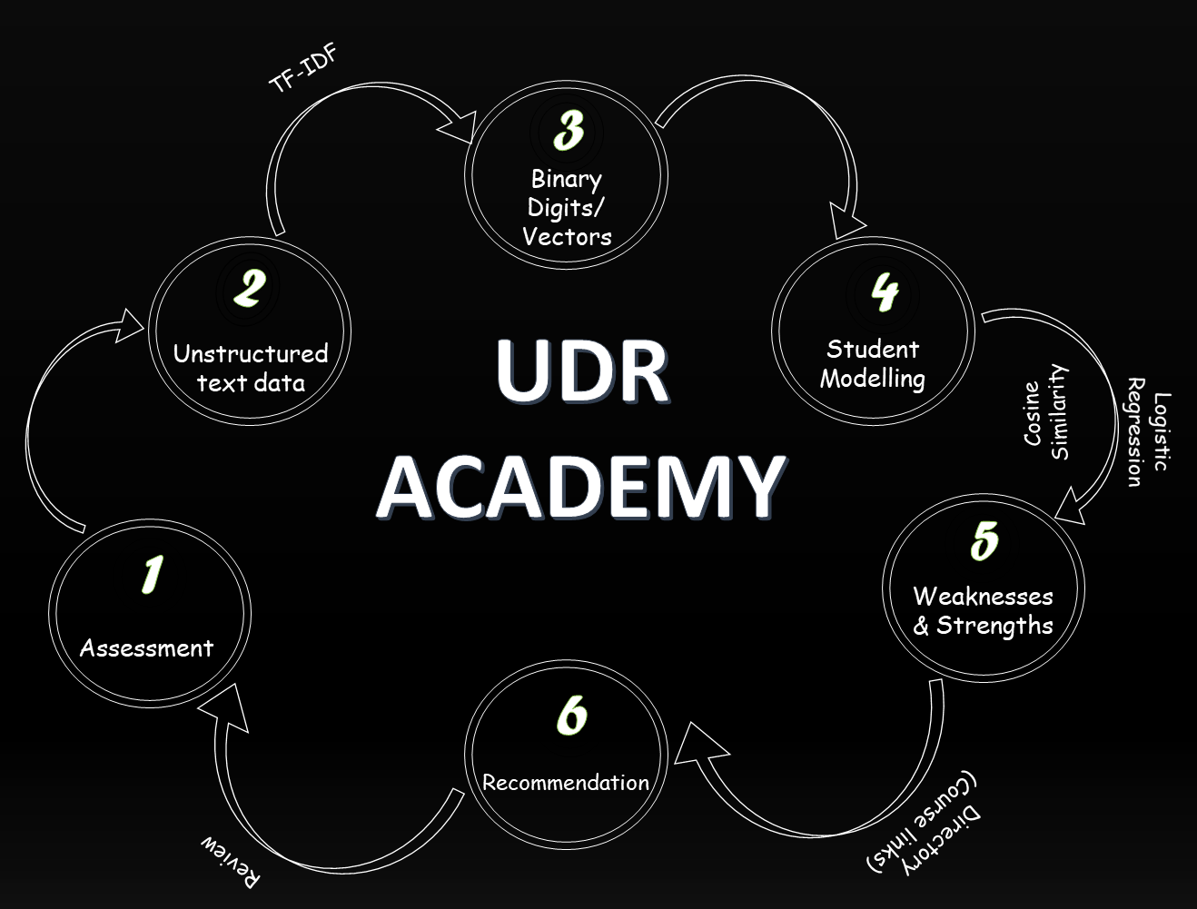
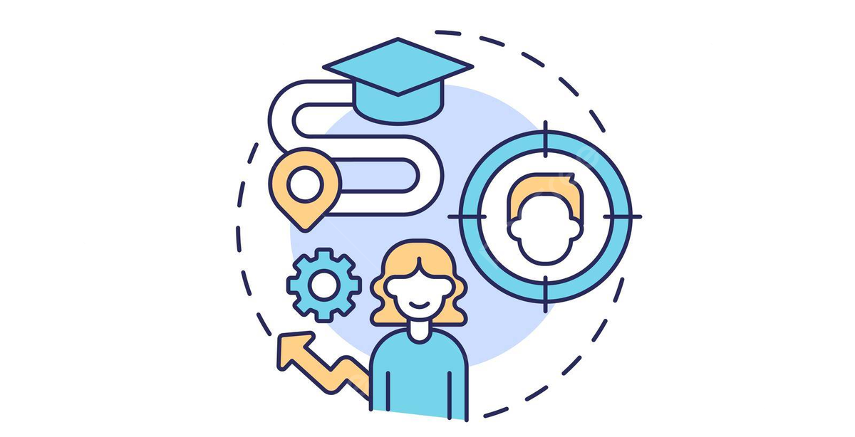

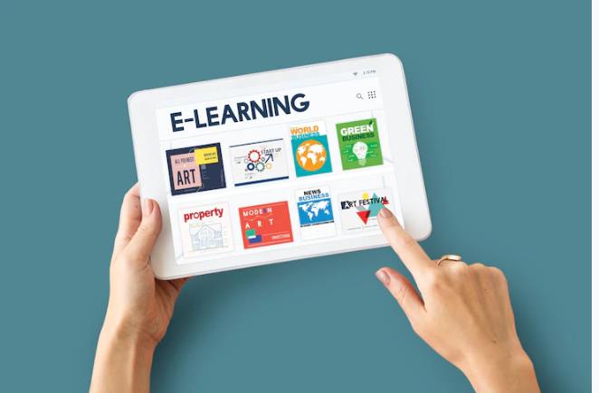

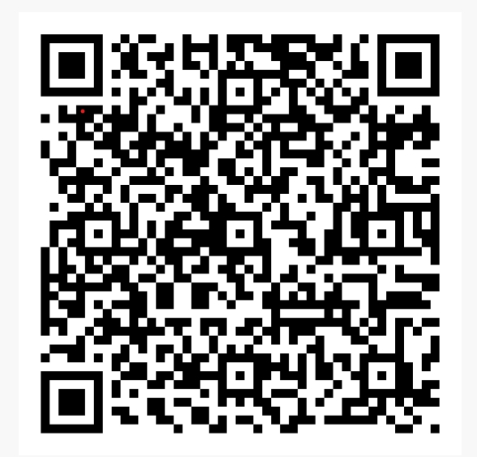
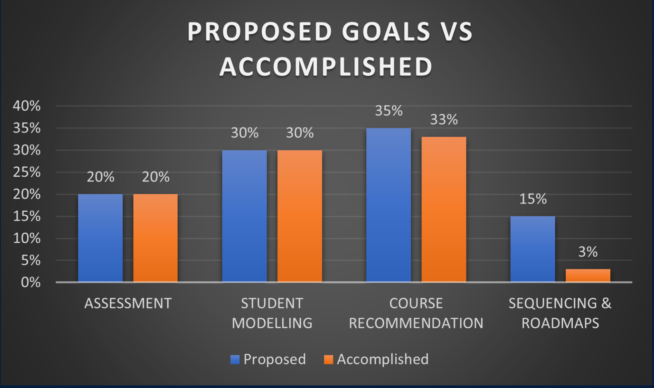
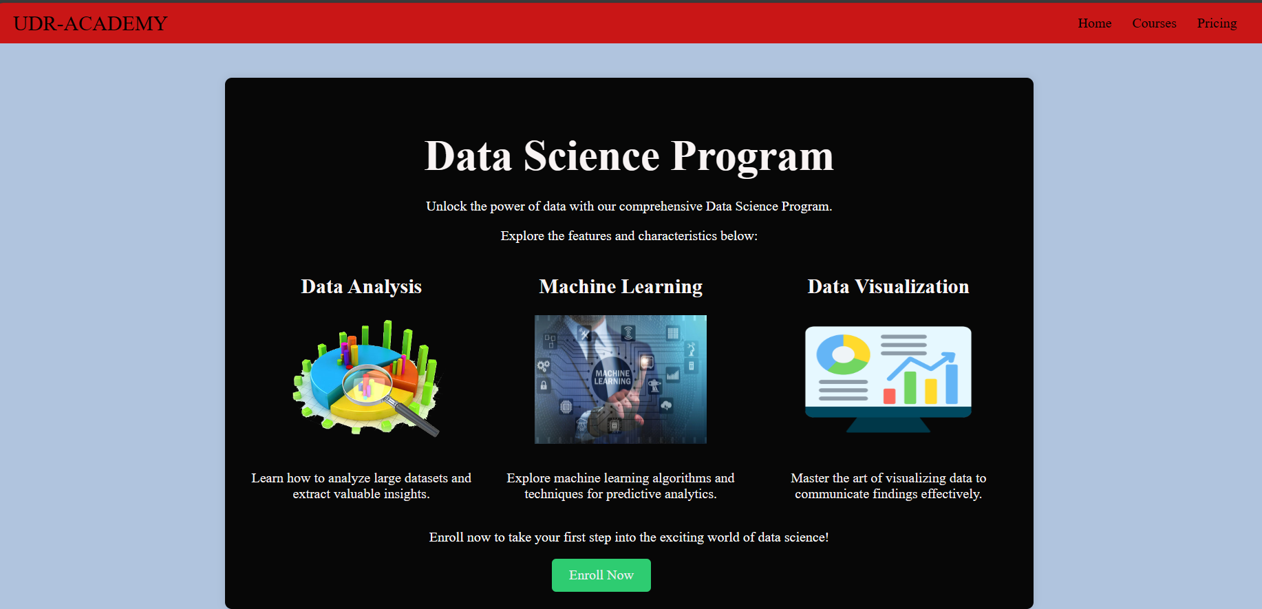
Enhancing Education Outcomes Through Personalized Learning System
What is personalized system?
What is Personalized
System ??
A personalized learning system is like a customized education plan that adapts to your strengths, weaknesses, and pace. It provides tailored materials, tracks your progress, and gives feedback to keep you engaged and motivated. It's education is designed just for you.
Our Mission
Transforming education with personalized learning: leveraging data science and technology to optimize strengths and ignite a lifelong love for learning.
Our Vision
Empowering lifelong learners with personalized education using technology and data to unlock individual potential and create a fairer educational system.
Goals and Objectives
Tackled Research Questions
Methodology
1.How can adaptive learning systems be improved to provide more personalized educational experiences for diverse learners?
2.What are the most effective algorithms for adapting content delivery based on individual student progress & preferences?
3.How can success in personalized AI education be accurately measured beyond traditional metrics?
Take Aways
References
Enhanced
Personalized paths
Increased engagement
Enhanced Learning Outcomes
Addressing achievement Gaps

